Slide 1
MINI Project Project Title: Sentiment Analysis on Google Pay Reviews
Name : Gowtham K
Register No: 22235136
School of Computing Sciences
DEPT: Information technology
2nd year MSc data science & Business analytics

Slide 2
Abstract
In an increasingly digital world, mobile payment applications like Google Pay have become integral to modern financial transactions
With millions of users worldwide, Google Pay accumulates a vast repository of user reviews. This study employs sentiment analysis techniques to extract valuable insights from a dataset of Google Pay reviews
By leveraging natural language processing (NLP), we categorize user sentiments as positive, negative, or neutral to uncover trends and patterns in user feedback
Our analysis aims to shed light on the overall user satisfaction with Google Pay, identify common pain points, and highlight areas for potential improvement. The results of this study can be valuable for both Google Pay developers and users, contributing to the enhancement of this widely used payment platform

Slide 3
Project Purpose
The purpose of this project is to perform sentiment analysis on customer reviews of Google Pay, a mobile payment application. Sentiment analysis is a natural language processing (NLP) technique that categorizes text data into positive, negative, or neutral sentiments, allowing for an understanding of user satisfaction and feedback. The project aims to extract valuable insights from a dataset of 40,000 Google Pay reviews collected from the Google Play Store.
Relevance
User Satisfaction: Analyzing user sentiments can provide insights into how satisfied or dissatisfied users are with Google Pay, helping the developers improve the application based on feedback.
Pain Points Identification: By categorizing reviews into positive and negative sentiments, common pain points and areas for improvement can be identified, giving developers specific areas to focus on.
Data-driven Decision-Making: This project demonstrates the application of data-driven decision-making in the field of mobile applications, showing the importance of analyzing user feedback to make informed decisions.

Slide 4
TOOLS & TECHNIQUES
Python: Python programming language as the primary tool for data preprocessing analysis
NLTK(Natural Language Toolkit)Library: NLTK will be used for various natural language processing tasks, including text preprocessing, tokenization, and potentially for sentiment analysis
VADER Sentiment Analysis: VADER (Valence Aware Dictionary and sentiment Reasoner) is a lexicon and rule-based sentiment analysis tool. It will help me calculate sentiment scores for the google pay reviews
Logistic Regression: This type of statistical model (also known as logit model) is often used for classification and predictive analytics. Logistic regression estimates the probability of an event occurring, such as voted or didn’t vote, based on a given dataset of independent variables. Since the outcome is a probability, the dependent variable is bounded between 0 and 1
Data-set description
Data Set Name: google pay Customer Reviews.csv
Source: Google Play Store
Purpose: Sentiment Analysis
Format: CSV (Comma-Separated Values)
Size:40000 rows × 6 columns(24000 data's)

Slide 5
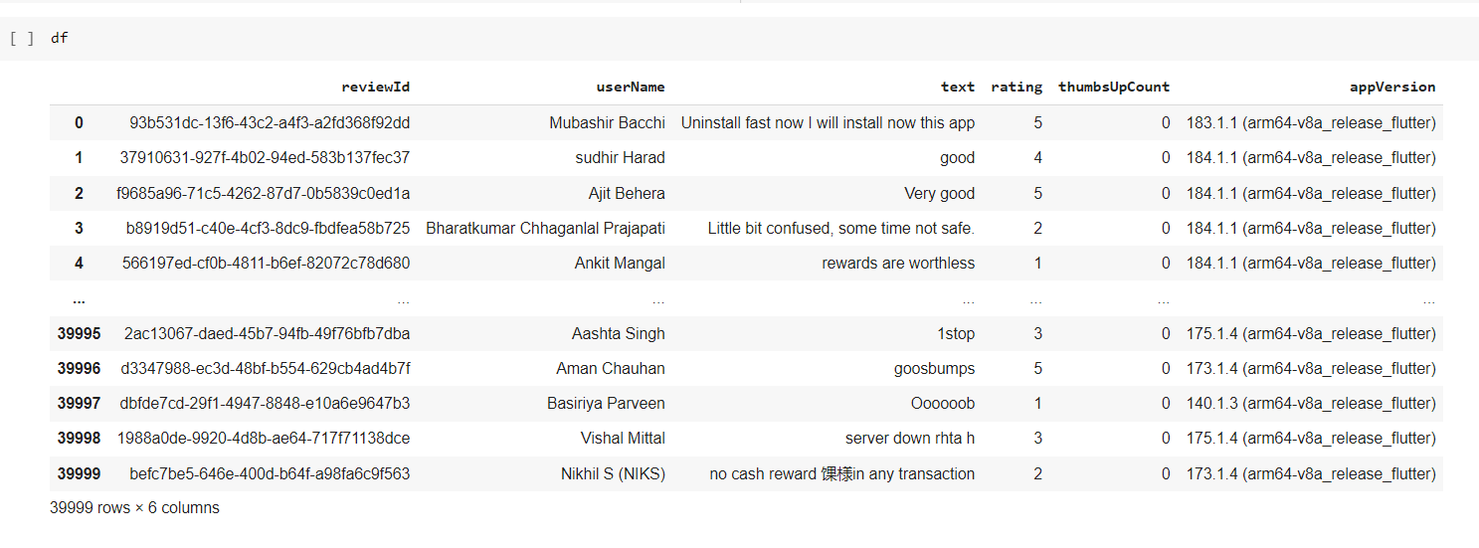
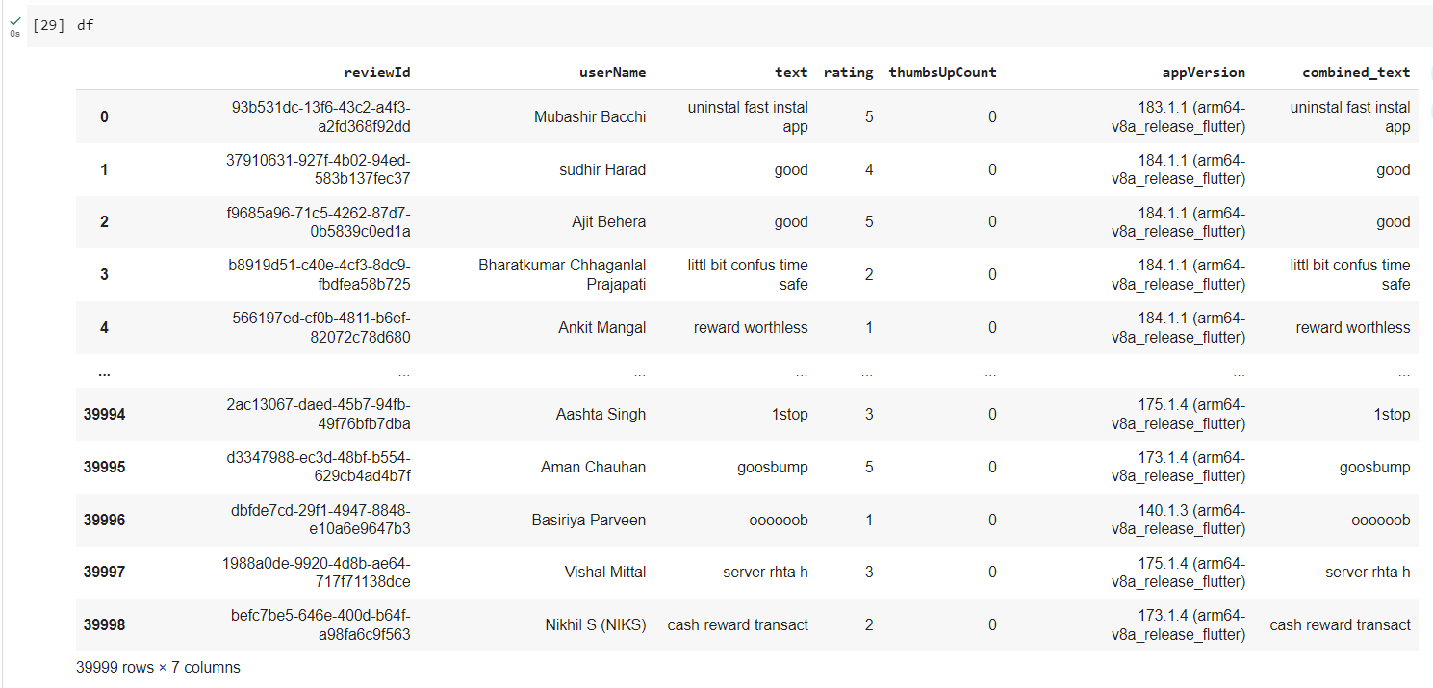
Dataset
Data Preprocessing
Data preprocessing steps, including handling missing values, text preprocessing (lowercasing, HTML tag removal, tokenization, symbol removal, stop word removal, emoji handling, and stemming), and combining pre-processed text into a single column

Slide 6
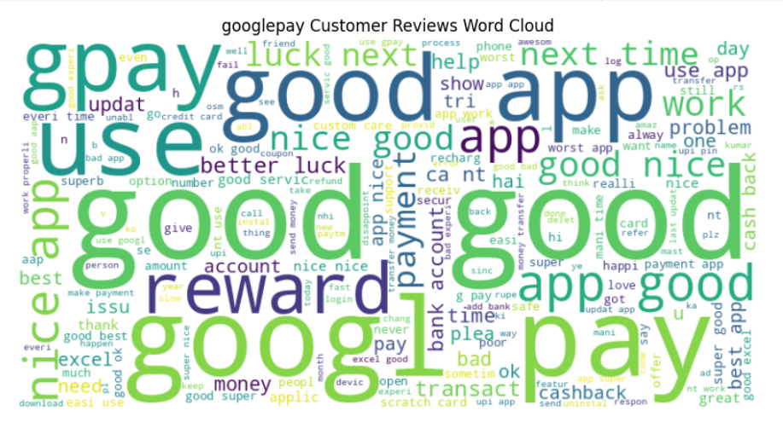
Word Cloud Visualization
Word Cloud visualization to visualize the most frequent words in the preprocessed text of customer reviews
A word cloud is a visual representation of text data in which words are displayed in varying sizes, with the size of each word indicating its frequency or importance within the text. Word clouds are often used to quickly and intuitively understand the most common words or terms in a given dataset.

Slide 7
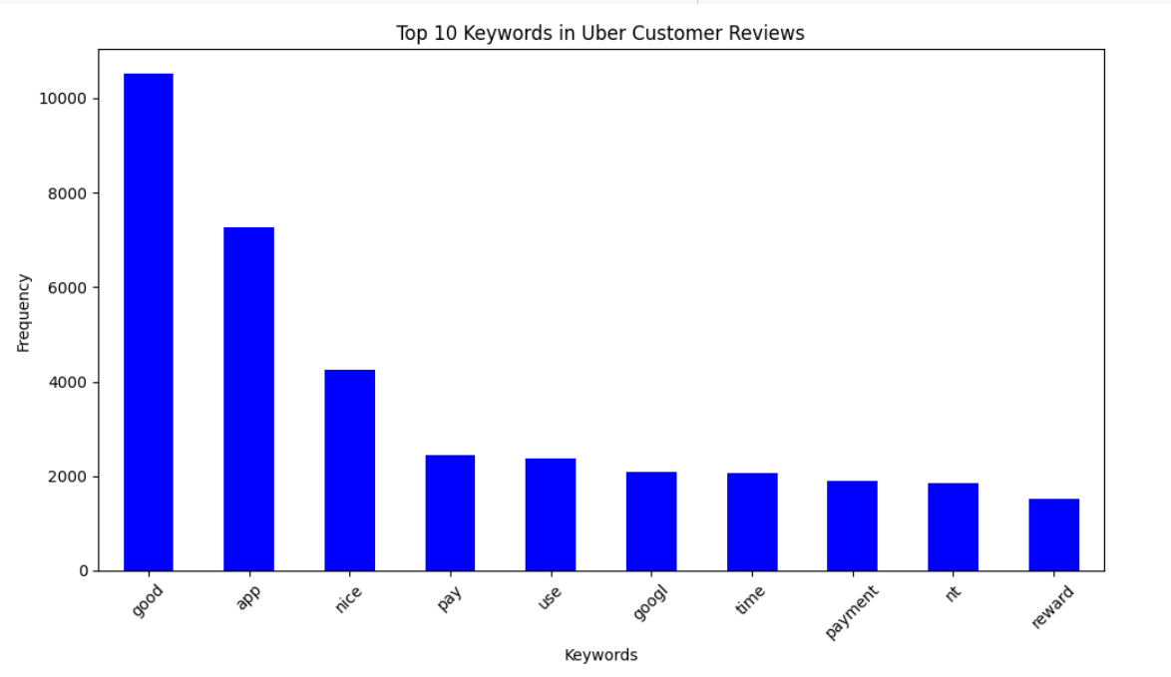
Top Keywords
The top keywords in reviews and understand how they can influence user sentiment, you would typically perform text analysis, including techniques like natural language processing (NLP) and sentiment analysis. The exact keywords and their influence on sentiment may vary depending on the context of the reviews, but I can provide a general approach:

Slide 8
Sentiment Analysis with Vader
VADER( Valence Aware Dictionary for Sentiment Reasoning) is an NLTK module that provides sentiment scores based on the words used. It is a rule-based sentiment analyzer in which the terms are generally labeled as per their semantic orientation as either positive, negative or neutral
Sentiment Score Calculation: For each token in the text, VADER looked up the token in its sentiment lexicon and assigned it a sentiment score based on the lexicon entry. The individual scores for each token were aggregated to calculate an overall sentiment score for the entire text. VADER considers various factors, including the degree of sentiment (e.g., "very happy" is more positive than "happy") and punctuation (e.g., exclamation marks indicating emphasis).
Compound Sentiment Score: The final sentiment score, often referred to as the "compound sentiment score," is a single numeric value that represents the overall sentiment of the entire text. This score takes into account the positive, negative, and neutral scores for all the tokens in the text and combines them into one value. The compound score can be positive (indicating a positive sentiment), negative (indicating a negative sentiment), or close to zero (indicating neutrality).
Mapping Sentiment Labels: To facilitate further analysis and visualization, the project mapped the sentiment labels ("positive," "negative," or "neutral") to numeric values (e.g., 1 for positive, 0 for neutral, and -1 for negative) for the creation of visualizations or machine learning models.

Slide 9
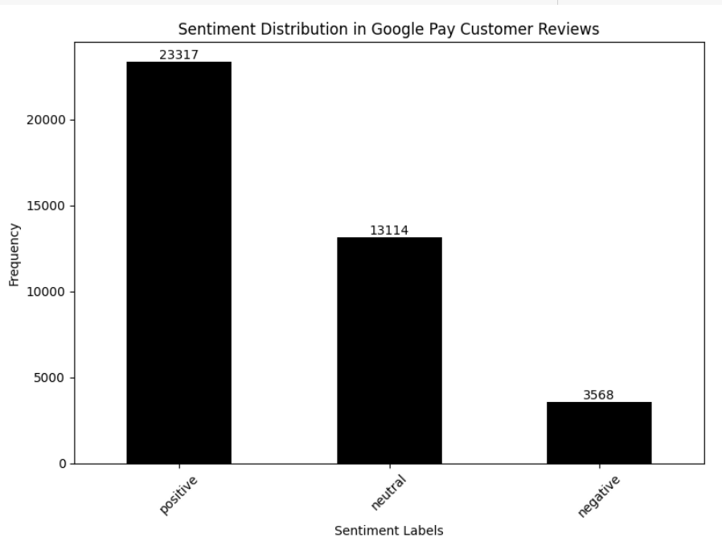
Sentiment Distribution Visualization:
Display a bar chart showing the distribution of sentiments (positive, neutral, negative).
Mention the number of reviews in each category.

Slide 10
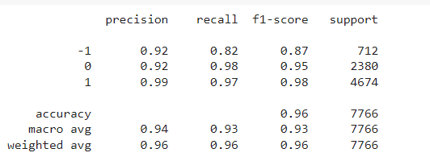
Machine Learning Model
Logistic Regression model is to learn the relationship between a set of input features and the probability of an instance belonging to one of two classes
Accuracy: the proportion of correctly classified instances.
Precision: the number of true positive predictions divided by the total number of positive predictions.
Recall: The number of true positive predictions divided by the total number of actual positive instances
F1-Score: The harmonic mean of precision and recall, which balances precision and recall.

Slide 11
Conclusion:
The project successfully analyzed the sentiment of Google Pay reviews.
Most reviews were neutral, suggesting a balanced mix of positive and negative feedback.
The Logistic Regression model proved effective in categorizing sentiment based on text data.
Insights gained from this analysis can help Google Pay make informed decisions to enhance user experience and address customer concerns.

